Slide 1


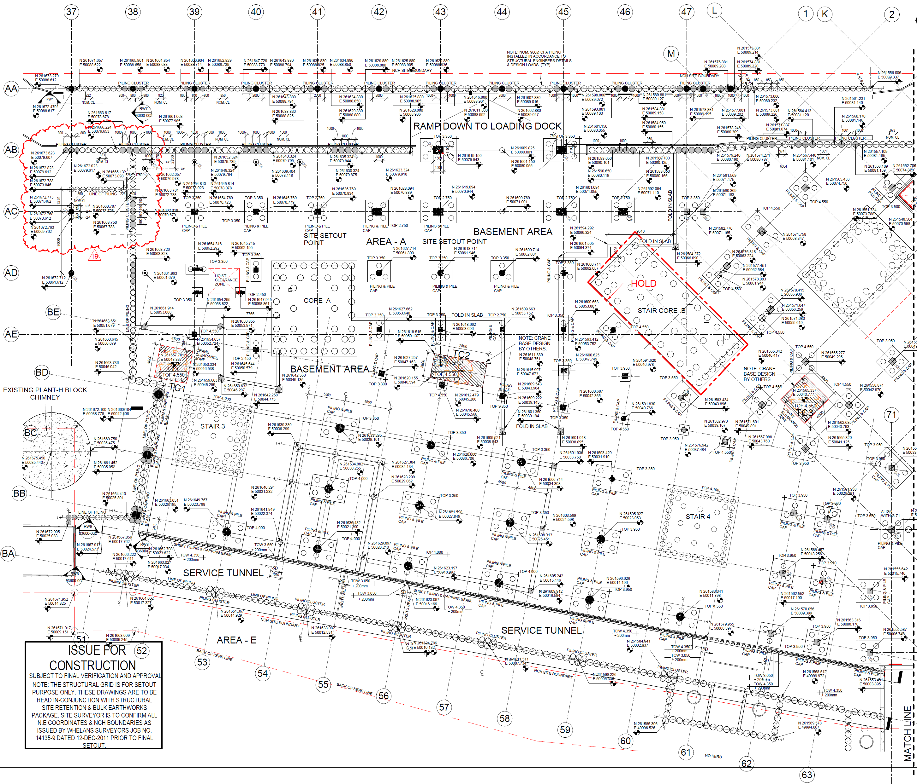
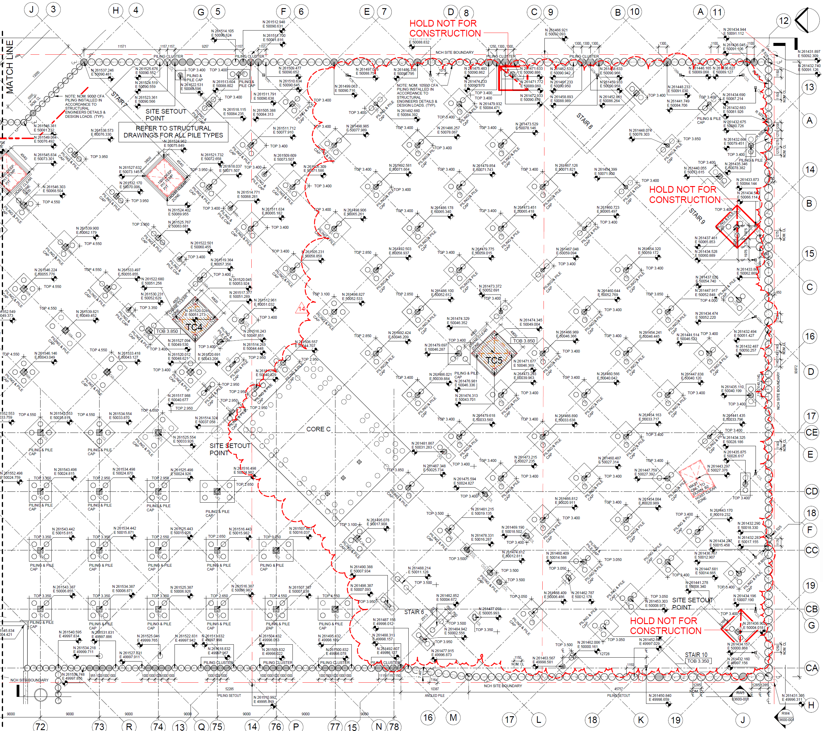
NCH: Mid Range Programme – Pile Cap Production Plan
EB ZONE 1
EB ZONE 2
SB ZONE 2
SB ZONE 4
Stair 7
1
10
CB ZONE 3
2
1
Stair 8
1
5
1
2
6
9
4
1
4
3
4
3
4
3
CB ZONE 4
2
3
4
Stair 9
8
Riser 1
4
1
2
2
Core B
5
6
3
Core A
7
5
SB ZONE 3
3
2
5
4
5
4
6
2
3
Stair 3
7
1
6
3
5
WB ZONE 3
4
4
Core C
4
WB ZONE 1
3
WB ZONE 2
Stair 4
3
3
5
1
2
2
SB ZONE 6
2
5
2
4
1
1
3
2
1
CB ZONE 1
1
CB ZONE 2
SB ZONE 1
SB ZONE 5
Stair 10
FUNDEX RIG SEQUENCING
ENTECCO RIG SEQUENCING
Rig Starting Point
UNCONTROLLED - FOR SEQUENCING INFORMATION ONLY

Slide 2
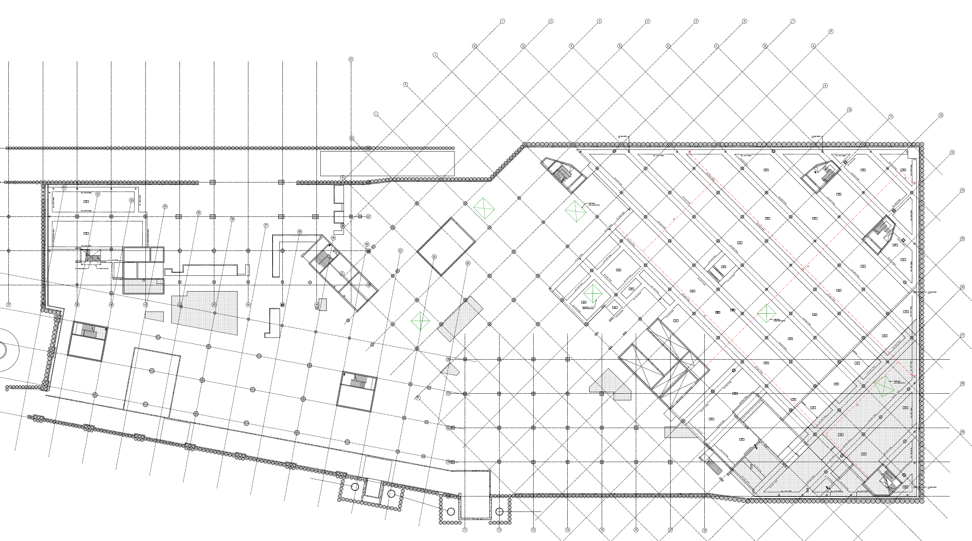
NCH: MRP (Aug-Oct 12) – Mandatory Completion Milestones (Upper Basement) (Substructure)
To Level G00
SB Zone 5
SB Zone 8
SB Zone 6
EB Zone 1
22-Nov-12
SB Zone 7
SB Zone 5
SB Crew #2
Start Point
SB Zone 1
SB Crew #1
Start Point
SB Zone 4
To Level G00
SB Zone 1
SB Zone 2
SB Zone 3
Crew Starting Area
West Block (WB)
Centre Block (CB)
East Block (EB)
South Block (SB)

Slide 3
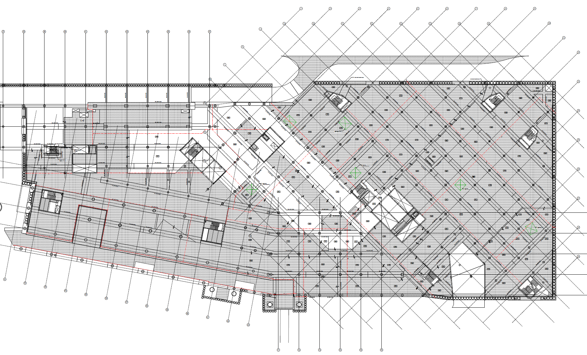
NCH: MRP (Aug-Oct 12) – Mandatory Completion Milestones (Ground Level)
SB Zone 8
SB Zone 6
EB Zone 1
14-Dec-12
EB Zone 2
17-Jan-13
EB Zone 3
21-Jan-13
SB Zone 9
EB Zone 4
18-Feb-13
CB Zone 4
17-Jan-13
SB Zone 7
SB Zone 5
SB Zone 1
WB Zone 3
728m2
12-Nov-12
CB Zone 5
SB Zone 4
WB Zone 1
8-Nov-12
WB Zone 2
9-Oct-12
SB Zone 2
CB Zone 1
31-Oct-12
SB Zone 3
CB Zone 2
6-Nov-12
CB Zone 3
8-Dec-12
West Block (WB)
Centre Block (CB)
East Block (EB)
South Block (SB)

