Slide 1
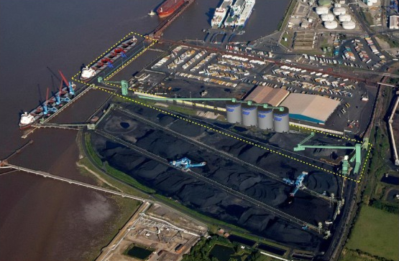
Conveyor system from quayside
Main storage silos
Lorry load out point
Rail load out point

