Slide 1
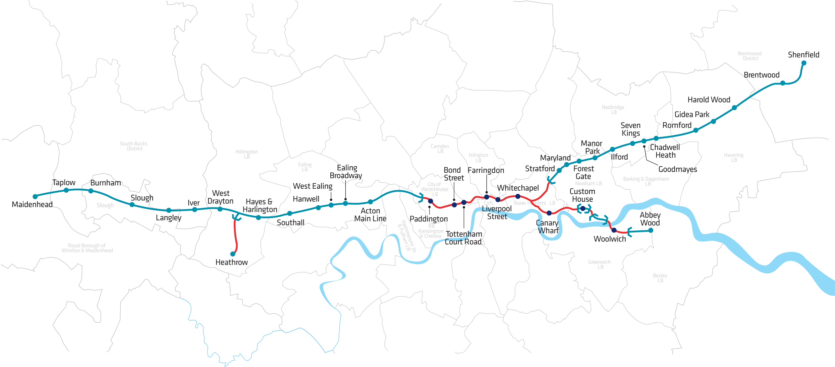
Denotes BFK contract responsibility

