Slide 1


350mm
γ=2300kg/m³
375mm
375mm
375mm
1.5m
0.648m
3.465m (0.495m ea.)

Slide 2
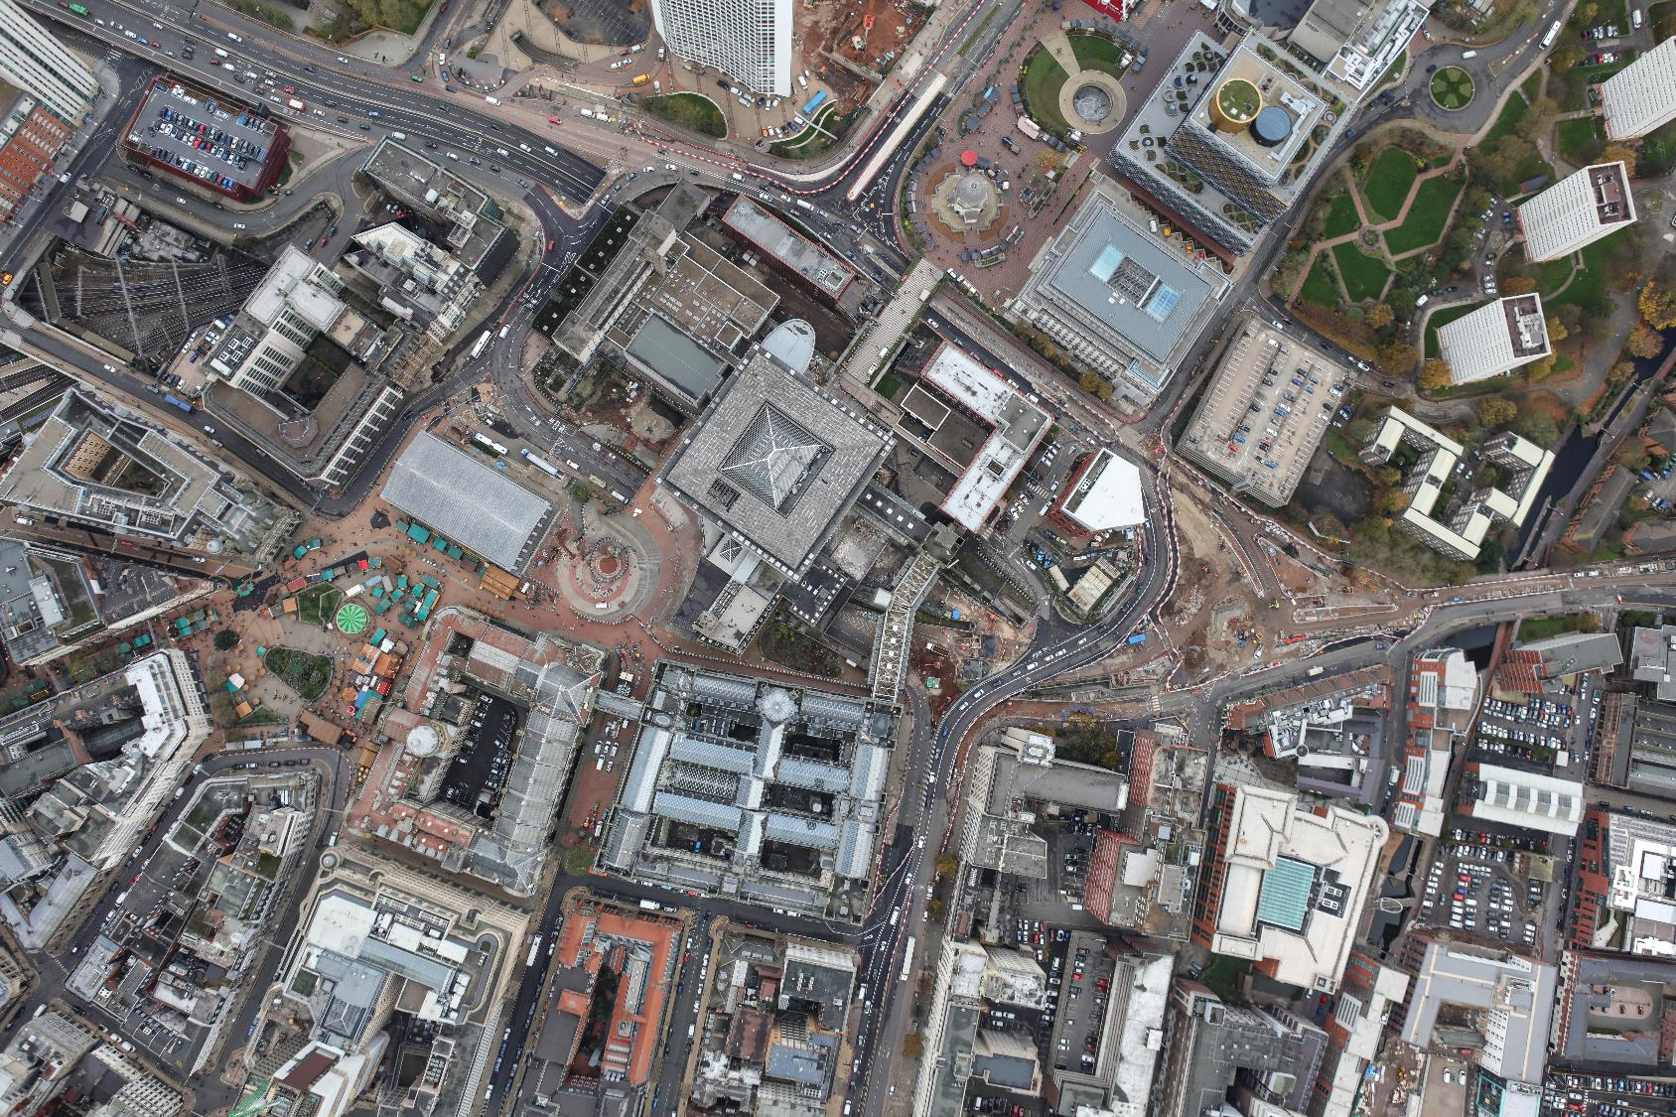

Slide 3
